Slide 1
Area-Optimized UAV Swarm Network for Search and Rescue Operations
Laik Ruetten
Paulo Alexandre Regis, David Feil-Seifer, Shamik Sengupta

Slide 2
Background
Defining the Problem

Slide 3
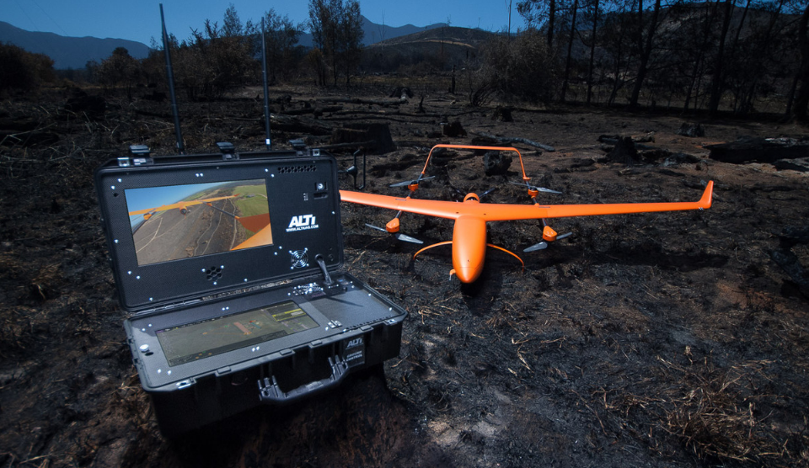
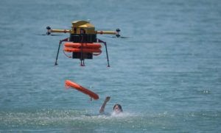
Background
Search and Rescue UAVs
Finding victims
Areas dangerous for humans
Still need a human operator
If we want more drones, do we need more human operators?
This is a limitation

Slide 4
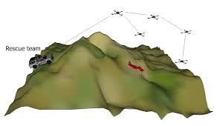
Background
Intelligent UAV Swarms
Self organizing
Larger area in less time
Number of UAVs not limited by human operators available
Reduces impact of poor battery life
Complex system with many parts

Slide 5
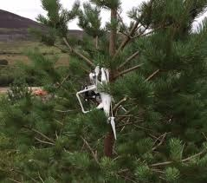
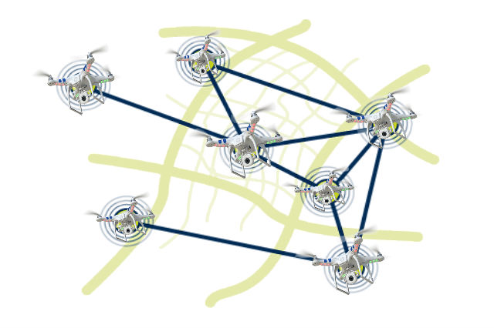
Background
Challenges
Need to search efficiently
Cover as much area as quickly as possible
Battery life
Emergency situations
Data is useless unless it can be transferred
Critical for UAV network to remain intact

Slide 6
Our Solution
We developed a system where each UAV in the swarm:
Spreads out as far as possible
Ensures that it is within range of the mesh network

Slide 7
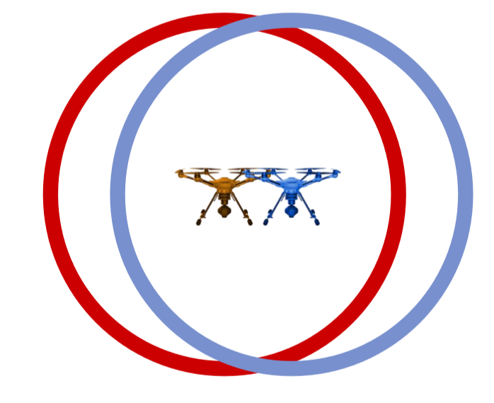
Radius of wireless communication

Slide 8
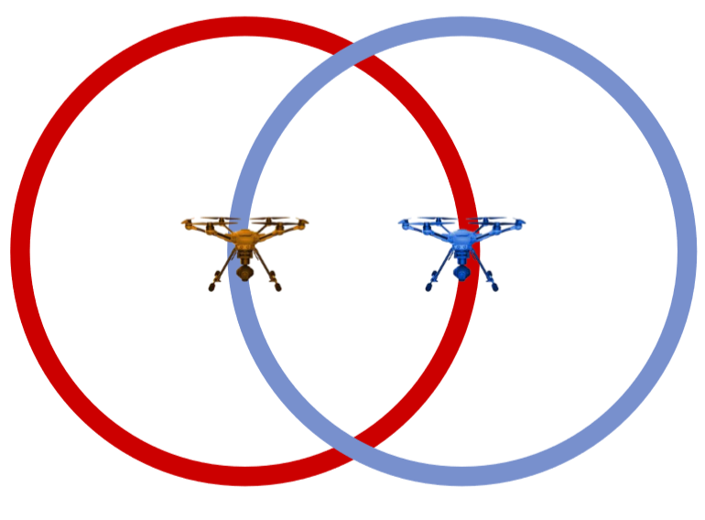
Optimized coverage

Slide 9
Previous Work
Left-Hand Search/the Rubber-Band method

Slide 10
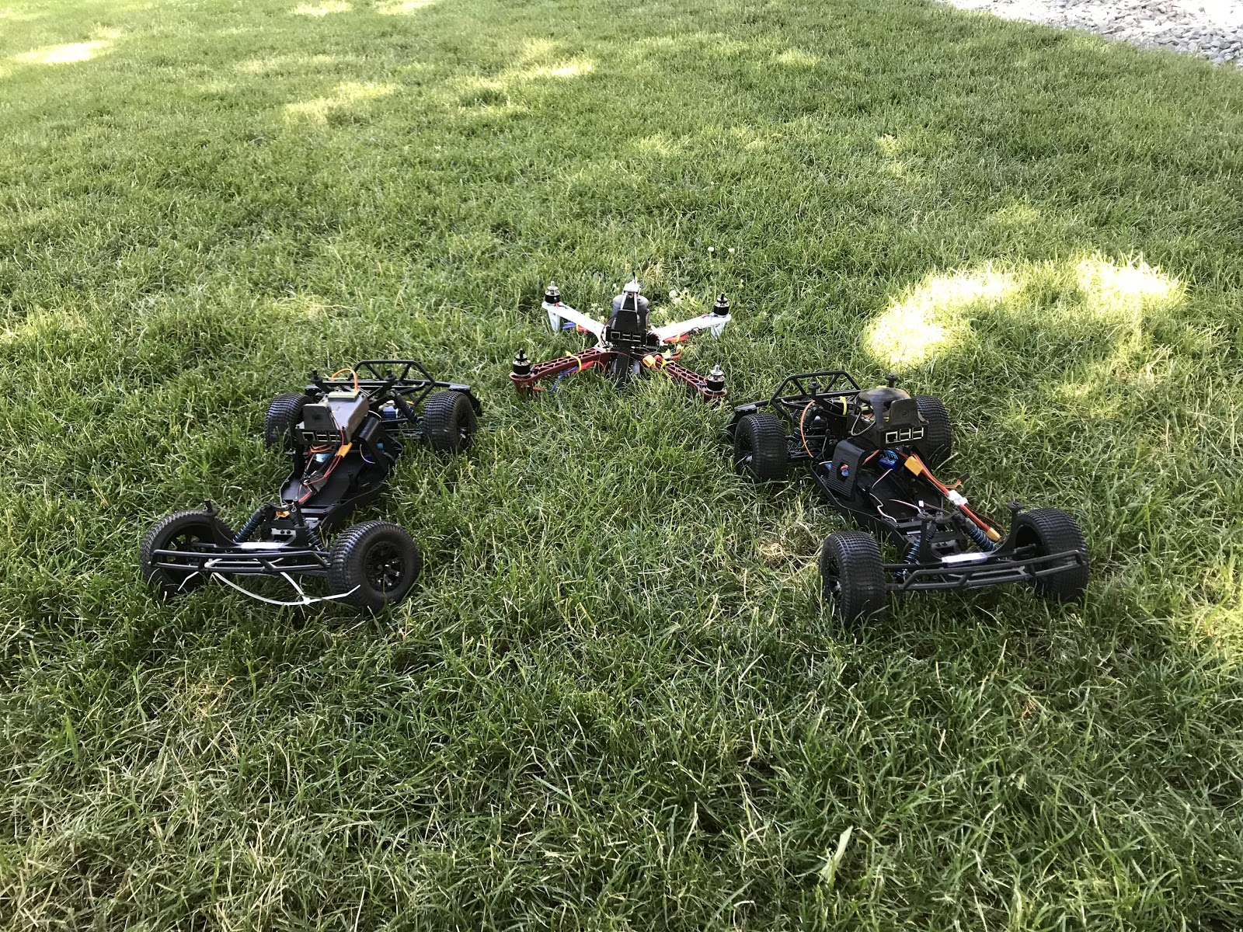
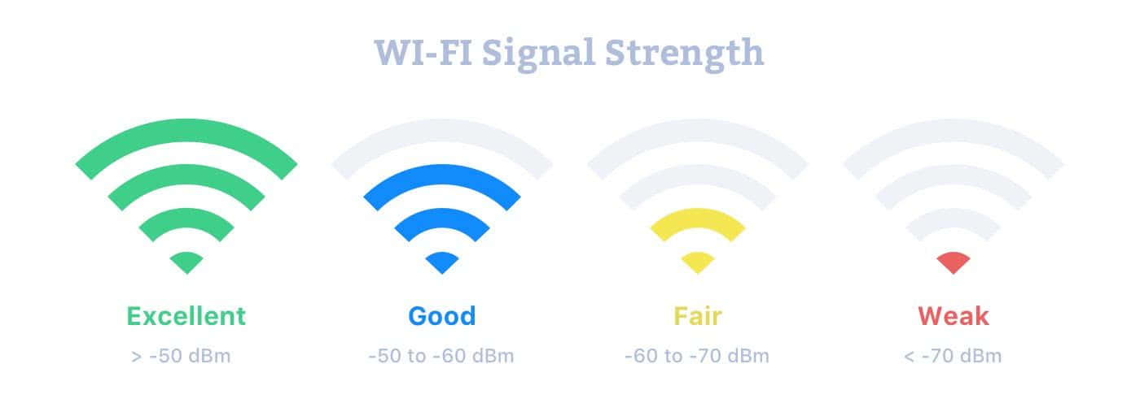
Previous Work
Left-Hand Search/the Rubber-Band method
One robot:
Driving forward
Other robot:
Drives closer when signal between gets weak (under a threshold)
RSSI - Received Signal Strength Indicator
“Search and Rescue Operations with Mesh Networked Robots”Tristan Brodeur, Paulo Regis, David Feil-Seifer, and Shamik Sengupta

Slide 11
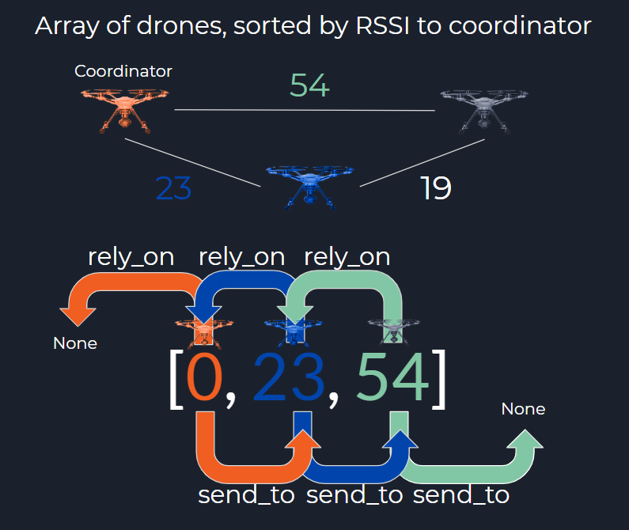
Previous Work
Array of UAVs, sorted by RSSI to coordinator

Slide 12
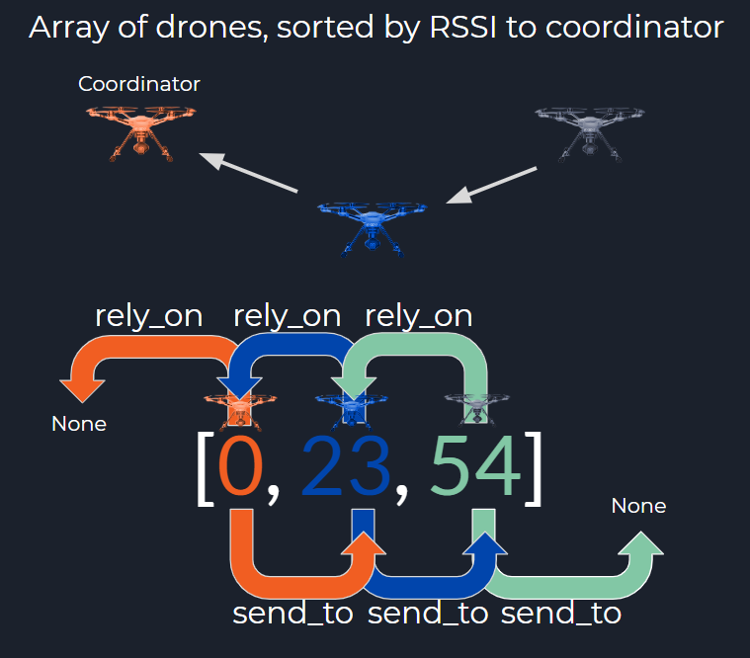
Previous Work
Array of UAVs, sorted by RSSI to coordinator

Slide 13
Proposed Work
Mesh Reliance Architecture

Slide 14
Straight Line Reliance Architecture
Array of UAVS, sorted by RSSI to coordinator

Slide 15
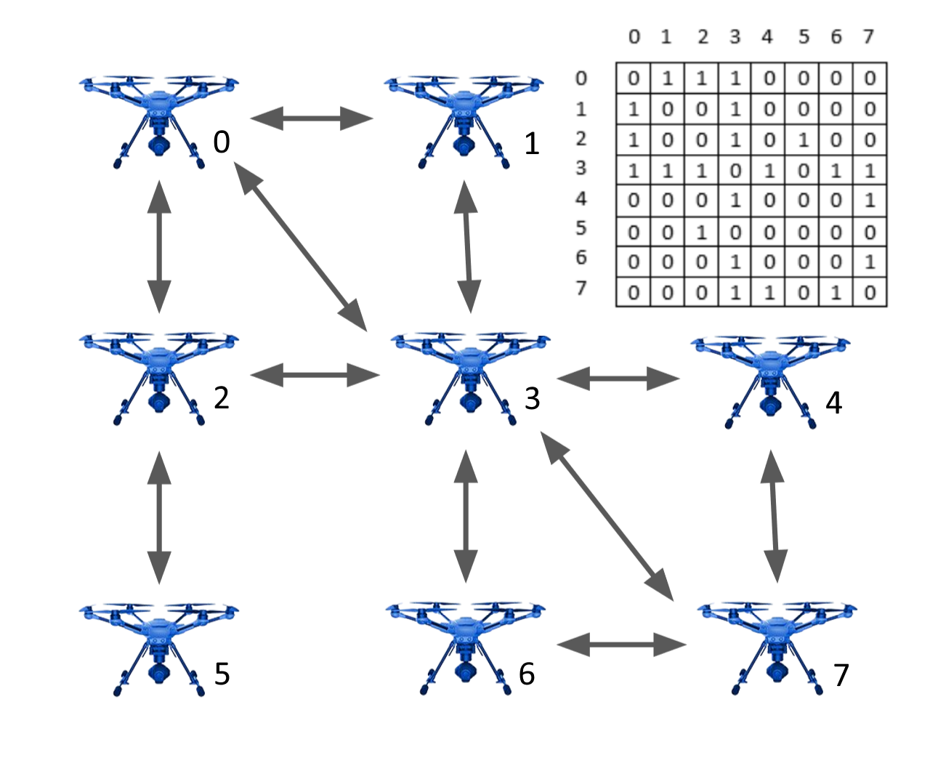
Mesh Reliance Architecture
Connectivity Matrix of UAVs, randomly assigned, no coordinator

Slide 16
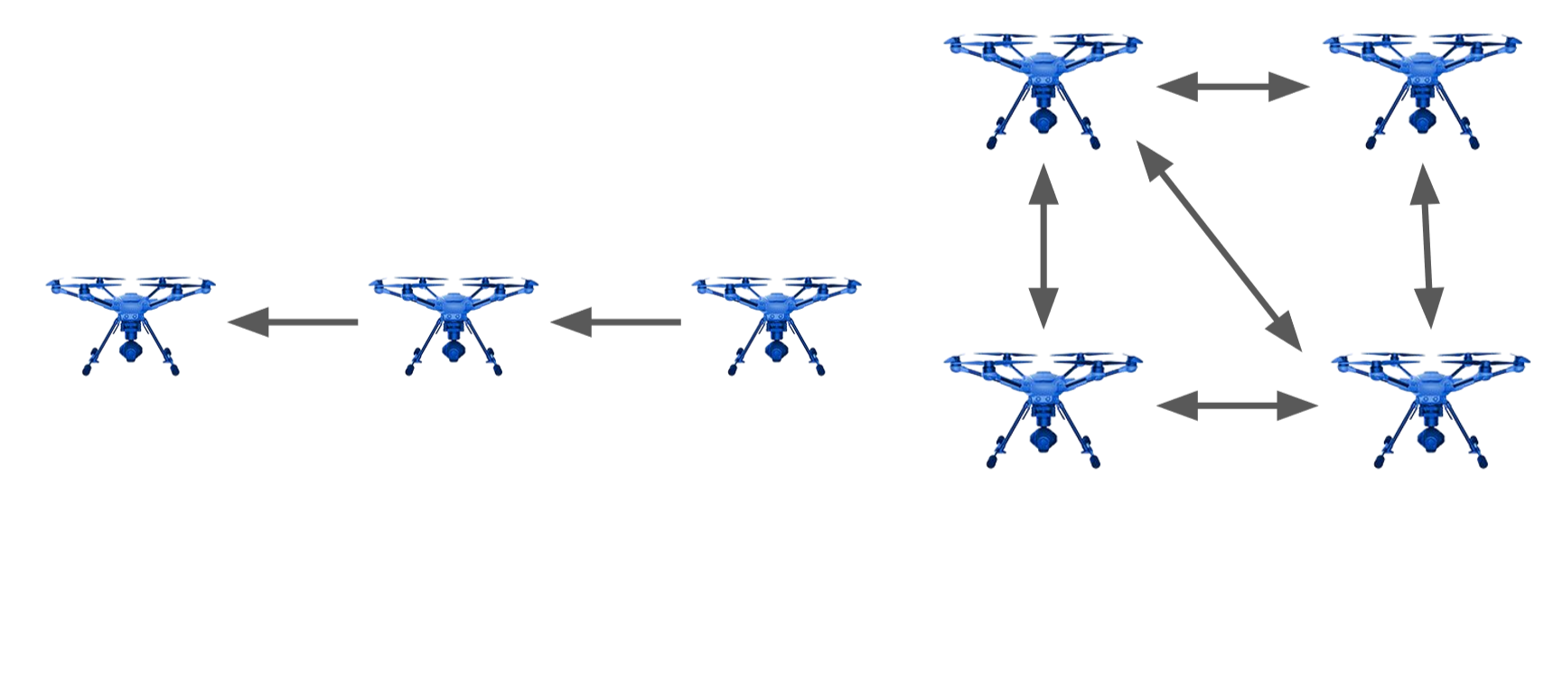
Mesh Reliance Architecture
Limits with SLRA Possibilities with MRA

Slide 17
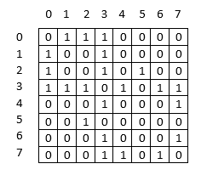
How Mesh Reliance Architecture is Created
Randomly creating a valid connectivity matrix
There must be at least one 1 in every row
There must be at least one 1 in every column
Each element on the row = column diagonal is a 0
Each UAV must be connected to at least one other UAV
All UAVs must be connected in one swarm (not multiple unconnected sub-swarms)
UAVs do not rely on themselves

Slide 18
Swarm Control Simulation
Tests in an ideal environment

Slide 19
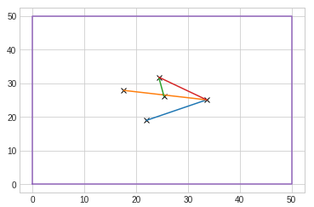
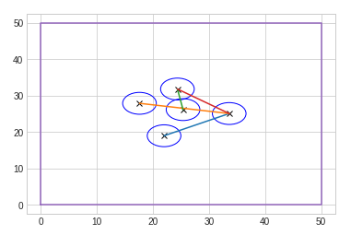
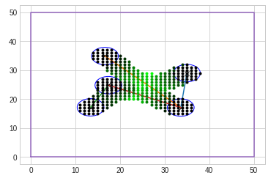
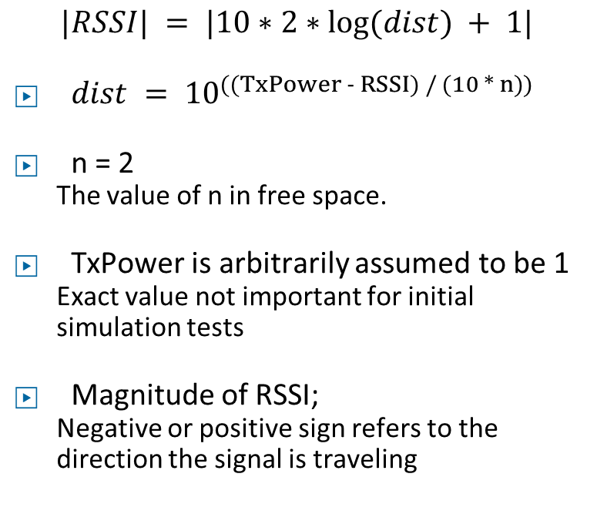
Swarm Control Simulation
Ideal Environment
$$|RSSI| = |10∗2∗log⁡(dist) + 1|$$
$dist = {10}^{((TxPower - RSSI) / (10 * n)) }$
n = 2
The value of n in free space.
TxPower is arbitrarily assumed to be 1
Exact value not important for initial simulation tests
Magnitude of RSSI;
Negative or positive sign refers to the direction the signal is traveling

Slide 20
Swarm Control Simulation
Ideal Environment
Each UAV’s sensors cover the same amount of area
A UAV moves the same distance every time and does move when it tries to move (no wind effects it, etc)
Battery life (time limit) depletes at a constant rate

Slide 21
Self Organization
Use of Genetic Algorithms to tune simple Neural Networks

Slide 22
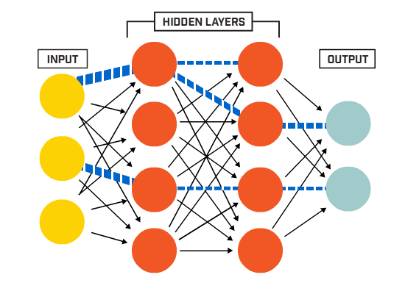
Self Organization
Use of Genetic Algorithms to tune simple Neural Networks

Slide 23
Self Organization
Use of Genetic Algorithms to tune simple Neural Networks
Input variables:
x_position
y_position
x_direction
y_direction
unsearched_N
unsearched_S
unsearched_E
unsearched_W
signal_strength
Output Variables:
x_direction
y_direction

Slide 24
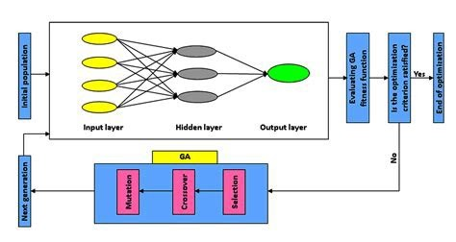
Self Organization
Use of Genetic Algorithms to tune simple Neural Networks

Slide 25
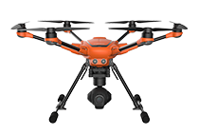
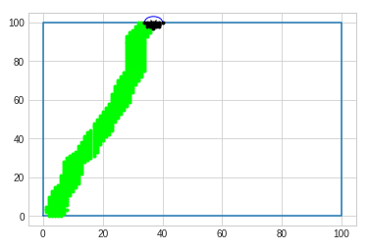
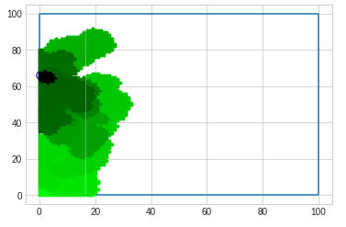
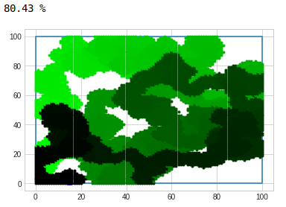
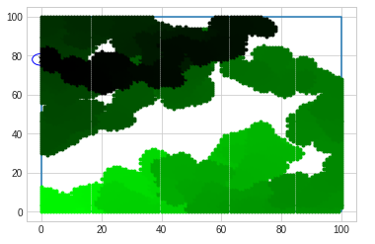
Test 1: Optimize Area-Coverage with one UAV
Generation 1 Generation 22
Generation 92 Generation 343

Slide 26
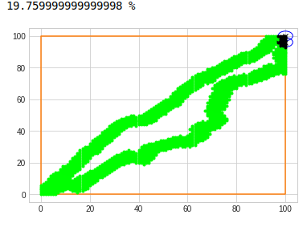
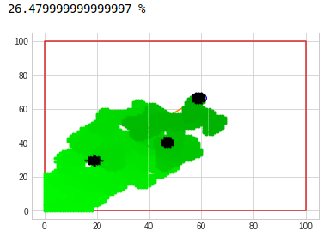
Test 2: Optimize Area-Coverage with multiple UAV

Slide 27
Test 2: Optimize Area-Coverage with multiple UAV
GA and Neural Networks could be methods to optimize the spread of a swarm communication network
Maybe not on board the drones themselves, but done and controlled remotely on a powerful computer

Slide 28
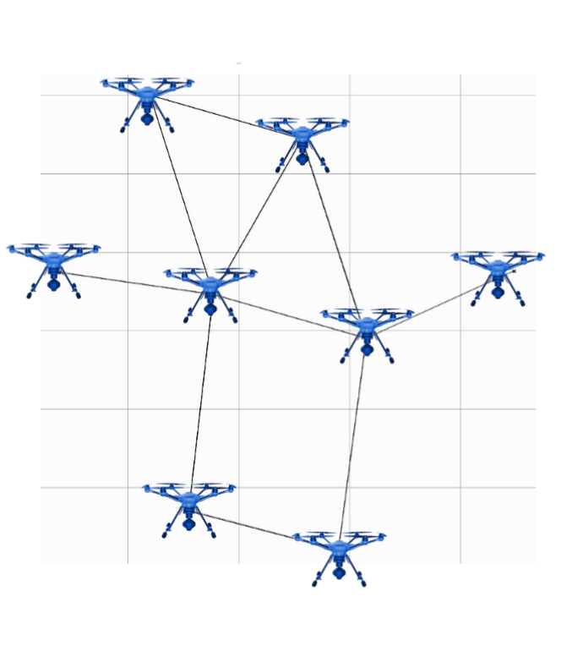
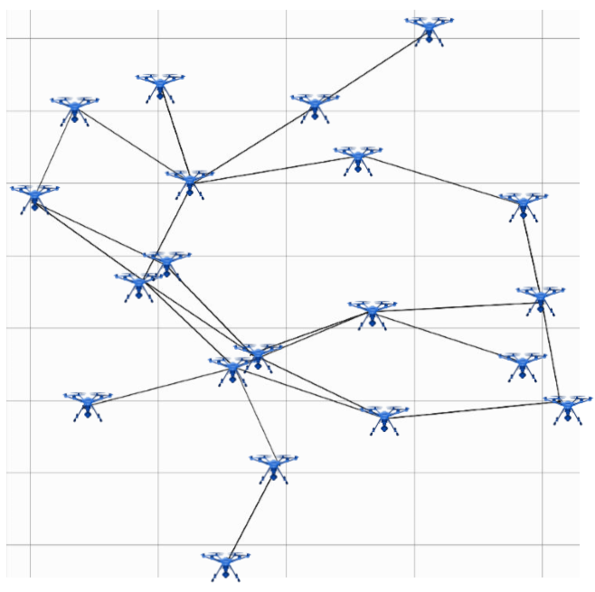
Test 3: Optimize Spread of UAV Swarm
Graphical results of simulation of spreading out UAV swarms
(Left: 8 UAV test result; Right: 20 UAV test result)
The lines show which UAVs rely on each other.
Some UAVs still end up close together due to not seeing UAVs that they do not rely on.
Future work will make the UAVs be able to change their reliance structure mid-flight.

Slide 29
Analysis and Conclusions
What worked and what could be improved

Slide 30
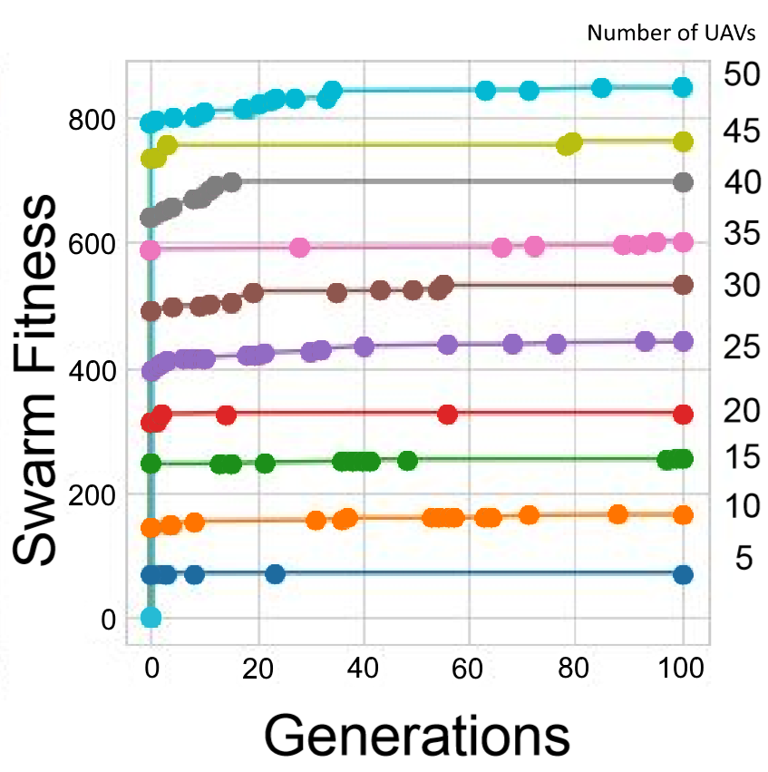
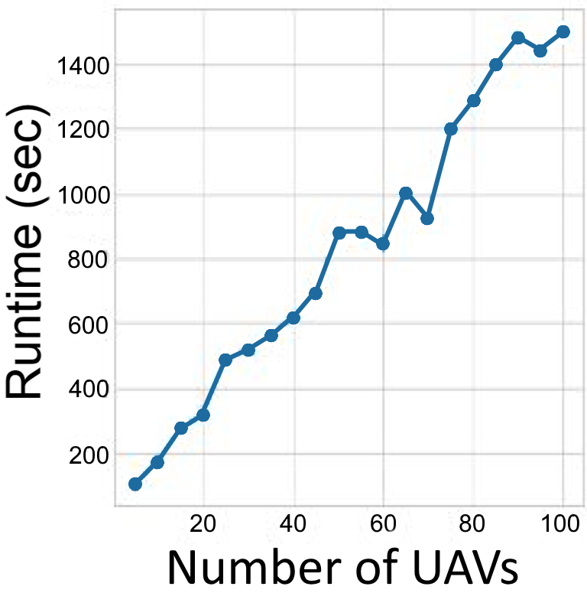
Analysis
The effect of number of UAVs on Performance
Number of UAVs only has a linear relationship with runtime
Number of UAVs does not affect the rate of progress of the algorithm
This was done in simulation on one computer; In future work, will run algorithm on each individual UAV computer in parallel to decrease runtime

Slide 31
Conclusions
What worked What could be improved
New system for reliance architecture
Optimal spread for UAV swarms
Linear performance
More efficient swarm control techniques
(improve GAs, or use different method altogether)
Run simulation in parallel on multiple computers
Mesh Reliance Architecture is static
(should be given ability to be dynamic)
Only a simulation, need to implement real-life system

Slide 32
Progress and Future Work
Improvements on both MRA and the control of it

Slide 33
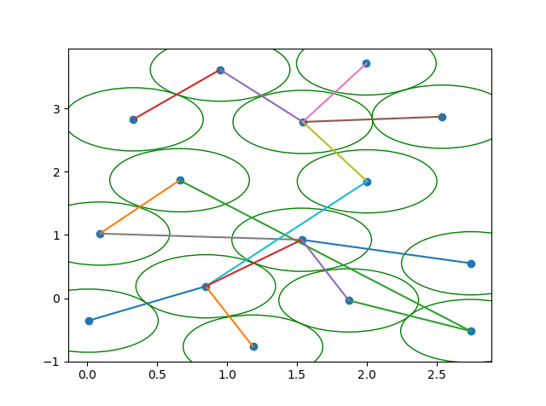
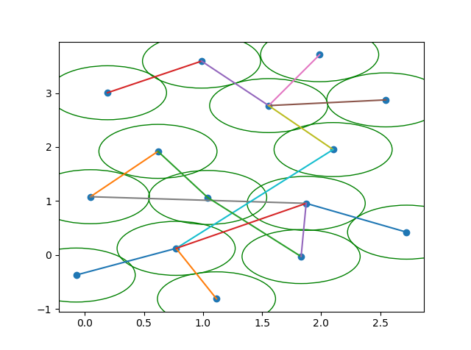
Improved GA Performance
Multi-objective optimization
Better results in same amount of time
Choose to value area-coverage over communication strength, or vice versa
Signal strength Area coverage

Slide 34
Dynamic Mesh Reliance Architecture
Changing reliance on-the-fly
10
2

Slide 35
Dynamic Mesh Reliance Architecture
Changing reliance on-the-fly
10
2

Slide 36
Dynamic Mesh Reliance Architecture
Changing reliance on-the-fly

Slide 37
Dynamic Mesh Reliance Architecture
Used to solve this problem

Slide 38
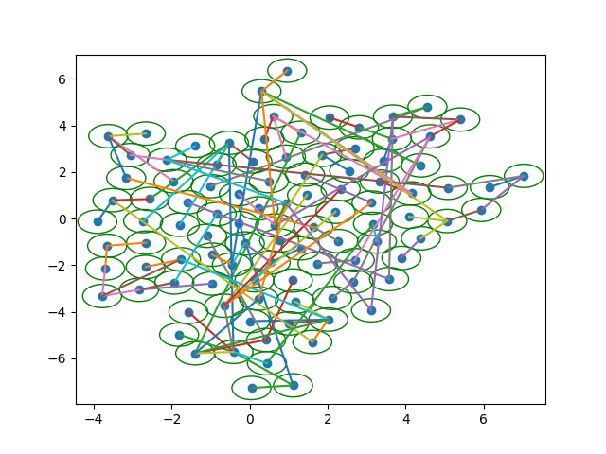
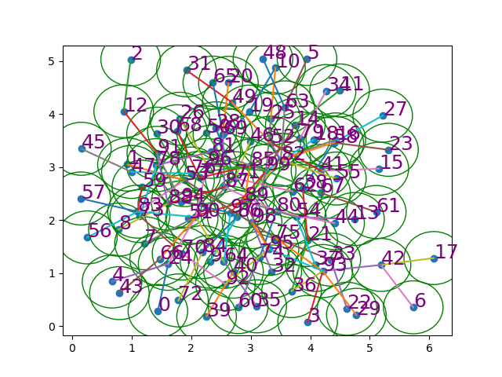
Support for more UAVs
100 UAV test
Without improvements vs with improvements

Slide 39
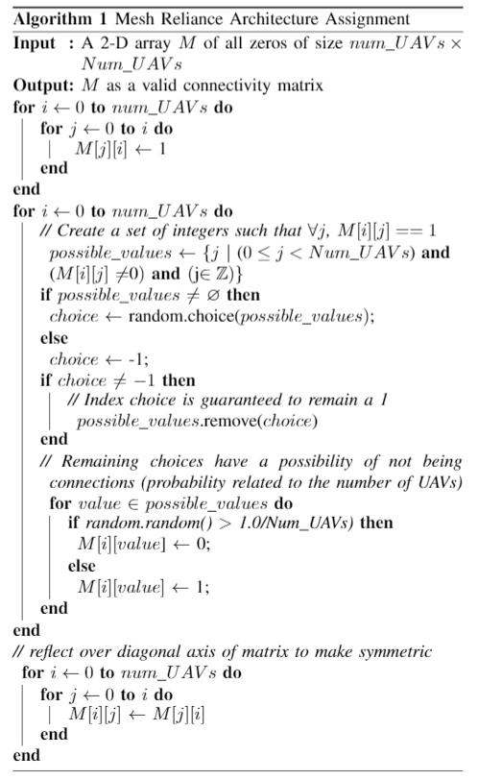
Fill the upper triangle with 1s
For every row,
Pick one 1 to remain a 1 no matter what
The remaining 1s change to 0s with a probability of
1.0/Num_UAVs
Reflect upper triangle over the row = column diagonal to the lower triangle

Slide 40
Fill the upper triangle with 1s
For every row,
Pick one 1 to remain a 1 no matter what
The remaining 1s change to 0s with a probability of
1.0/Num_UAVs
Reflect upper triangle over the row = column diagonal to the lower triangle

Slide 41
Fill the upper triangle with 1s
For every row,
Pick one 1 to remain a 1 no matter what
The remaining 1s change to 0s with a probability of
CONNECTIVITY = 1.0 CONNECTIVITY/Num_UAVs
Reflect upper triangle over the row = column diagonal to the lower triangle

Slide 42
Fill the upper triangle with 1s
For every row,
Pick one 1 to remain a 1 no matter what
The remaining 1s change to 0s with a probability of
CONNECTIVITY = 0.5 CONNECTIVITY/Num_UAVs
Reflect upper triangle over the row = column diagonal to the lower triangle

Slide 43
Fill the upper triangle with 1s
For every row,
Pick one 1 to remain a 1 no matter what
The remaining 1s change to 0s with a probability of
CONNECTIVITY = 0.1 CONNECTIVITY/Num_UAVs
Reflect upper triangle over the row = column diagonal to the lower triangle

Slide 44
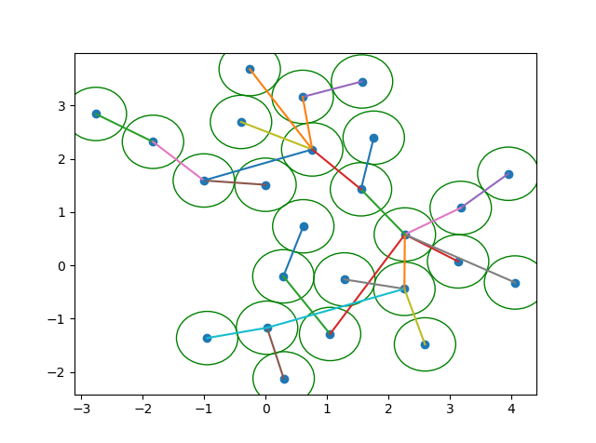
20 UAVs Connectivity = 1.0
25 UAVs Connectivity = 0.1

Slide 45




Acknowledgements
This material is based upon work supported by the National Science Foundation under Grant No. IIS-1757929. Any opinions, findings, and conclusions or recommendations expressed in this material are those of the author(s) and do not necessarily reflect the views of the National Science Foundation.

